Slide 1









RECIPE RECOMMENDATION SYSTEM
TEAM MEMBERS: HENIBEN PRAJAPATI, IMANJOT DEOL, JAY SHAH, NISHCHAL SINGI, SHARATH KUMAR

Slide 2


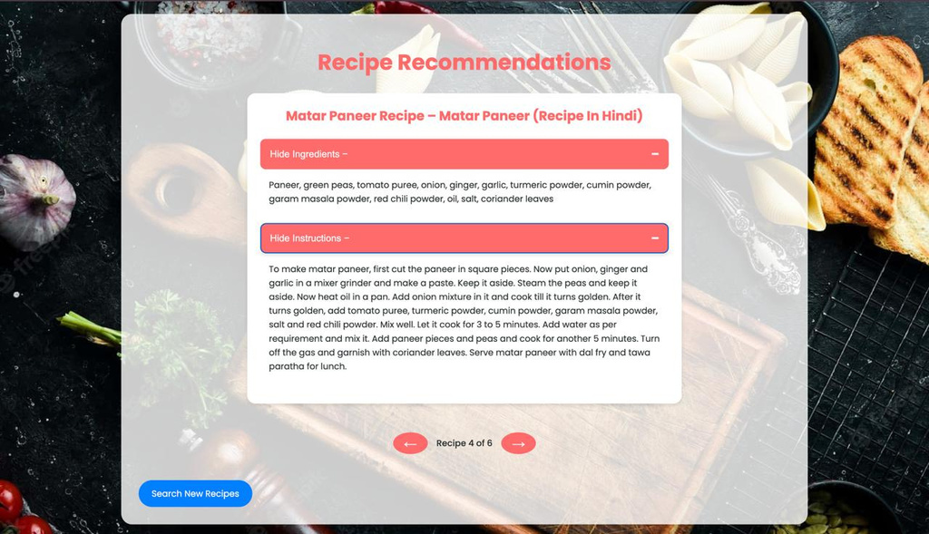


PROBLEM STATEMENT
Struggles in finding tailored recipes due to diverse dietary needs, time constraints, and ingredient limitations.
Objective: Simplify meal planning with personalized, machine-learning-based recipe recommendations.

Slide 3


INTRODUCTION
The Recipe Recommendation System is designed to simplify meal planning for students and working professionals by offering personalized recipe suggestions tailored to individual tastes, dietary needs, and time constraints. Using machine learning techniques like Word2Vec and TF-IDF for natural language processing, the system analyzes recipe data to deliver relevant and precise recommendations. By leveraging features such as cuisine type, dietary preferences, and available ingredients, it ensures users can easily discover recipes suited to their specific requirements. The user interface, built with HTML, CSS, and JavaScript, provides a seamless and engaging experience, making cooking more efficient, accessible, and enjoyable.

Slide 4


DATASET
Removed null values and duplicates to clean the dataset.
Calculated total time as Cook Time + Prep Timeand grouped recipes into:
Under 10 mins
30 mins
1 hour
The dataset contains 11 columns, 6028 unique recipes, and detailed descriptions of cuisines, courses, and diets.

Slide 5
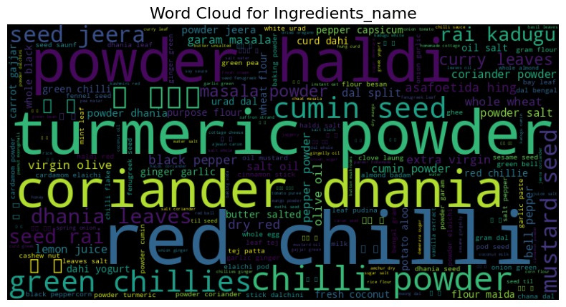
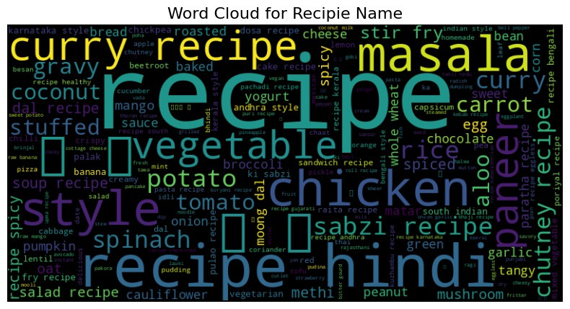
DATA VISUALIZATION
Recipe Name
Ingredients Name

Slide 6
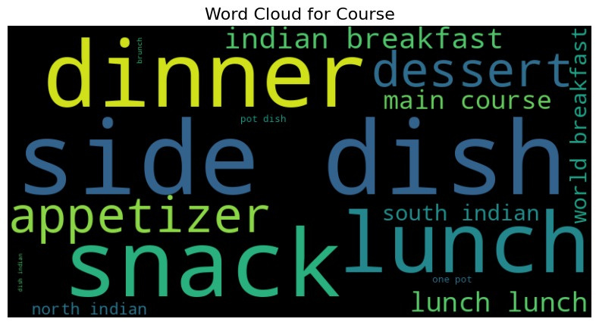
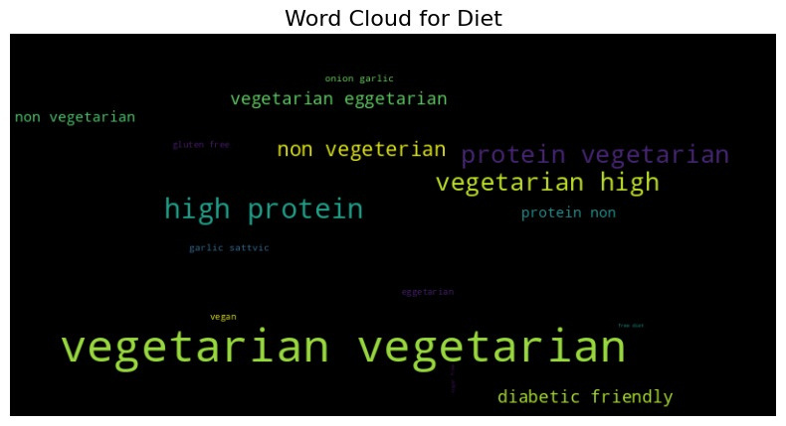
DATA VISUALIZATION
Diet
Course Name

Slide 7
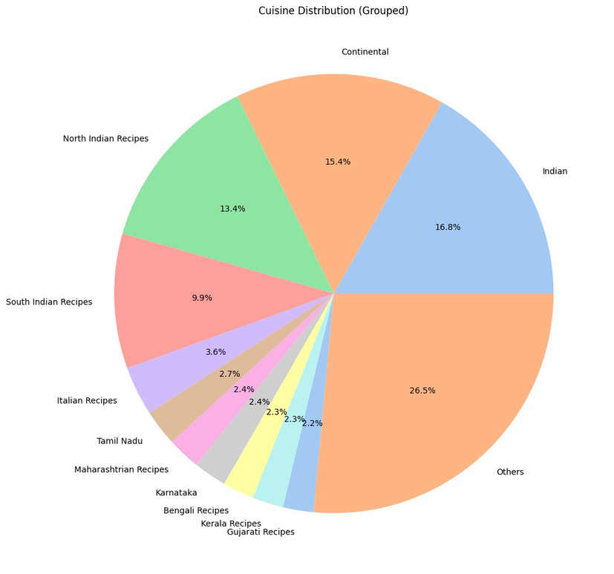
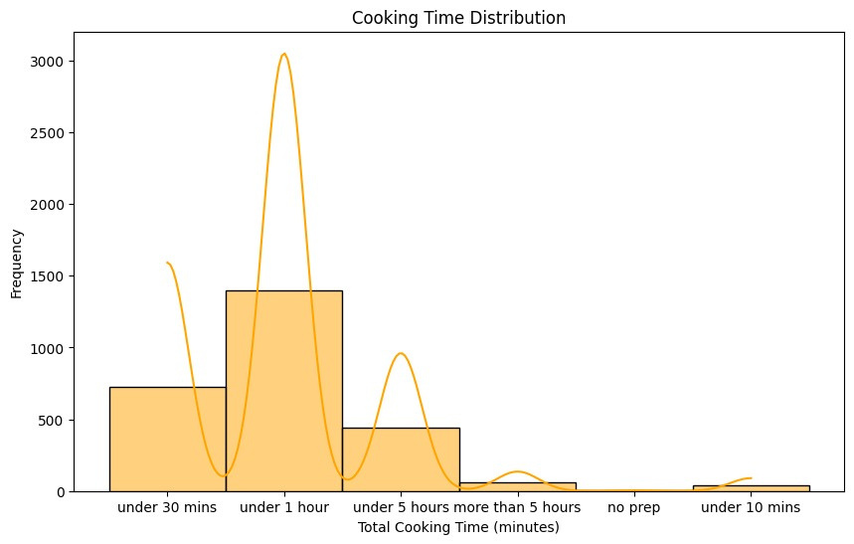
DATA VISUALIZATION
Cooking Time Distribution
Cuisine Name

Slide 8




METHODOLOGY
1. Problem Identification
2. Data Collection and preprocessing
3. Model Development
4. Implementation
5. Testing and Evaluation

Slide 9


IMPLEMENTATION DETAILS
Text Processing
Storing Processed Data
Tokenized text into:
Recipes
Ingredients
Whole data
Pickle files
Feature Extraction
Word Embeddings:
Word2Vec
TF-IDF Vectorization

Slide 10
IMPLEMENTATION DETAILS
Find Similar Recipes
Frontend Integration
Vectorize user input
Compare embeddings using Cosine Similarity
Results displayed include:
Recipe name
Ingredients
Preparation steps

Slide 11

CHALLENGES
Handling sparse data in collaborative filtering.
Missing values in critical fields like preparation time and ingredients.
Ensuring recommendations align with user preferences for cuisine, diet, time, and ingredients without overly simplifying or overloading the system.
Current models don’t account for allergies.

Slide 12

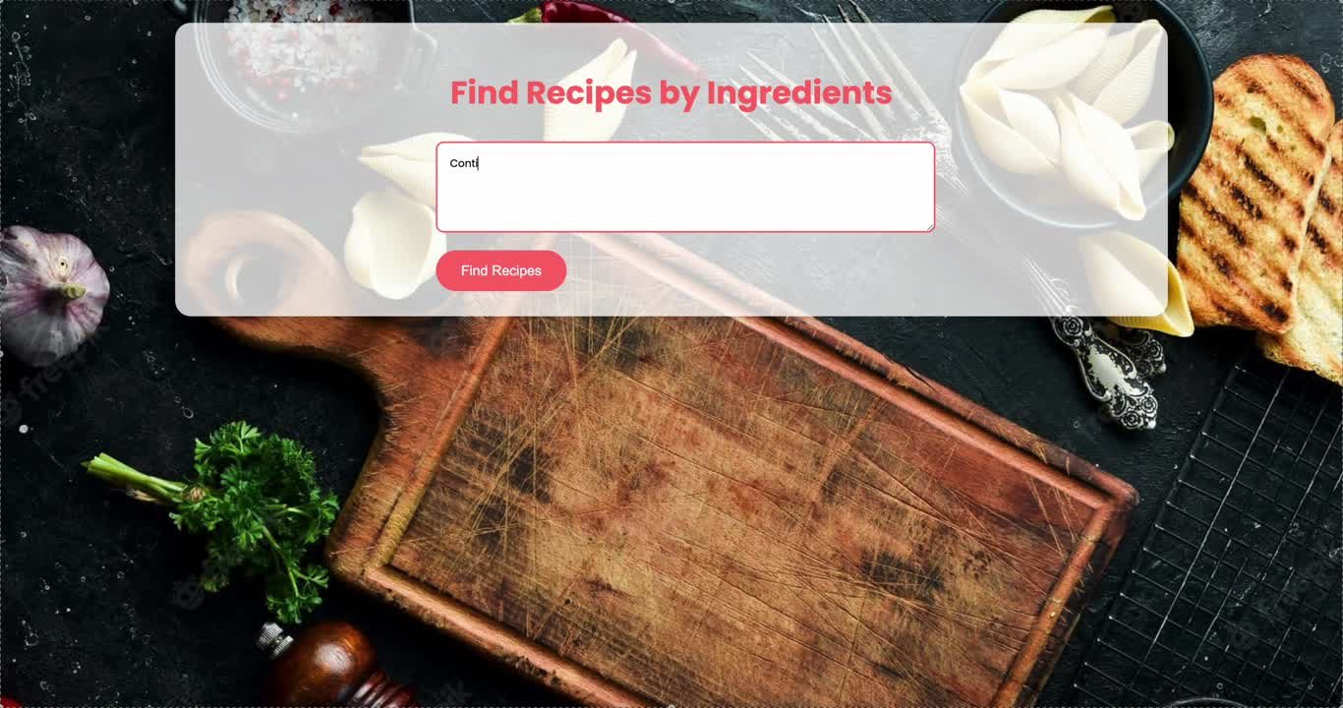
DEMO

Slide 13
THANK YOU!

